Slide 1

Project Guide :
Mr. Mahesh Shittlani Sir
Course Coordinator :
Mr. Kalpesh Tripathi
Name | PRN
BHUSHAN NANA GAYAKWAD | 230330920004
SHUBHAM GANPATRAO PATIL | 230330920012
SHANKAR AVINASH NAIKWADE | 230330920008

Slide 2
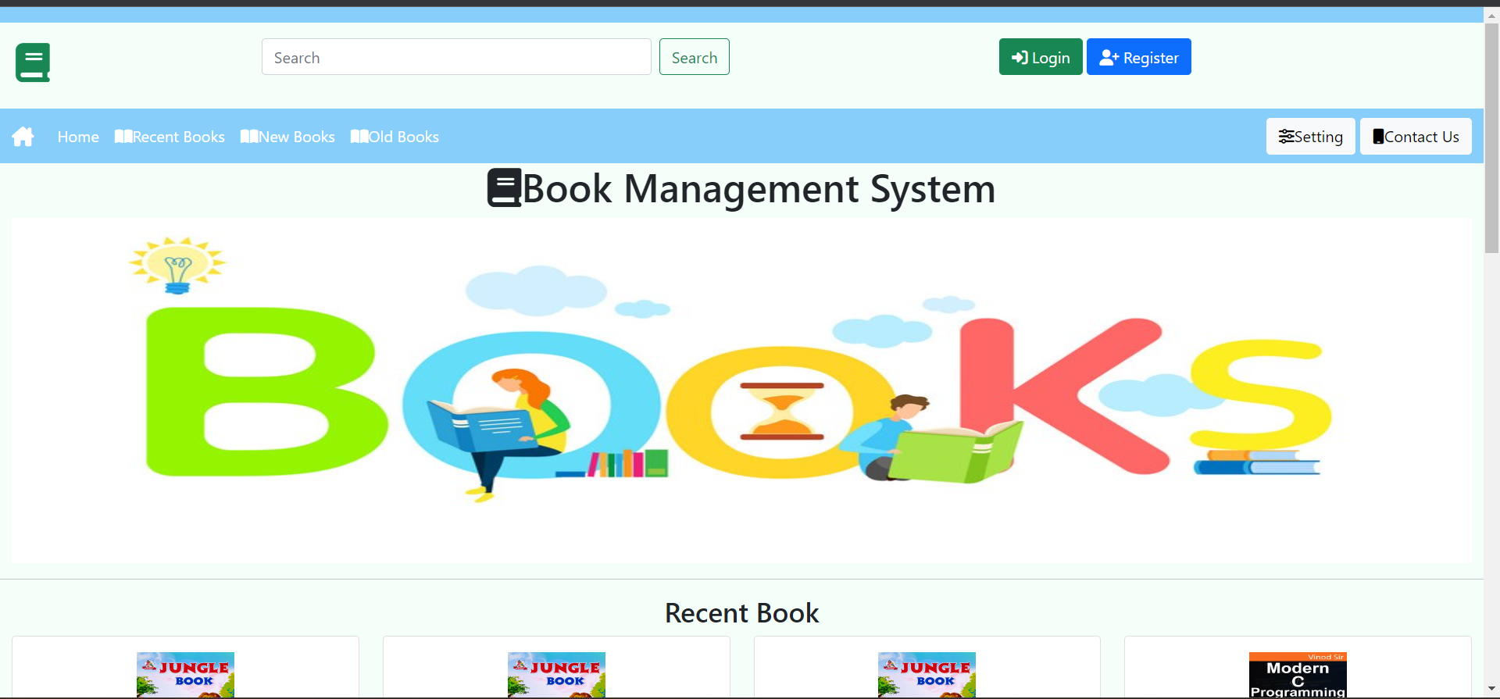
Book Store WEB APPLICATION.

Slide 3
What is Book store
An online bookstore software projects that acts as a central database containing various books in stock along with their title, author and cost.
This project is a website that acts as a central book store.
The user may select desired book and view its price.
The user may even search for specific books on the website.

Slide 4
What we do ?
Our System is an Books store website from where people can buy Books online.
Admin monitors the activity of the users and checks the transactions.

Slide 5
Sources we used.
Languages
Jsp
Servlet
MySQL

Slide 6
Features
Menu
Catalog Browsing
Product List
Product Browsing
Shopping Cart Checkout
Auto generated bill

Slide 7
What admin can do?
Display Admin Dashboard
Admin can Add , Delete, Update Books
Admin can See all order
Admin can see all old and new books

Slide 8
WhaT user can do
User can register himself
View all available old and new books
User can view book details
User can add new books to cart
User can add old books for reselling
User can place order and see order status

Slide 9
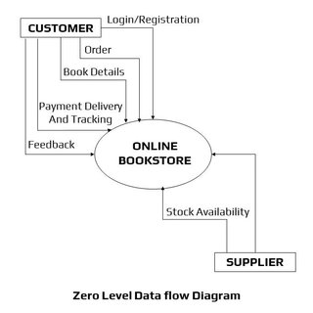
Data Flow Diagram

Slide 10
Advantages
Faster buying/selling procedure, as well as easy to find Books.
Low operational costs and better quality of services.
No need of physical company set-ups.
Easy to start and manage a business.

Slide 11
Disadvantages
Unable to examine products personally.
Not everyone is connected to the Internet.
Mechanical failures can cause unpredictable effects on the total processes.

Slide 12
Future plans
We are thinking of some modifications and adding some advanced new features in out system. Some of them are -
Improve UI.
Users can Sell their Books.
Mobile Reading
Audio book

Slide 13
Thank You !

